Slide 1
Bridging the Gap Between Prevention and Treatment: A Public Health Imperative
Prof Geoffrey Setswe DrPH, MPH
Health Professionals Symposium
Theme: Integrating Preventive & Curative Care in Multidisciplinary Health Practice
Date: 12 January 2026
Venue: Virtual

Slide 2
Introduction
South Africa has a quadruple burden of disease consisting of HIV/AIDS, communicable disease, non-communicable disease & violence & injuries.
South Africa has the world’s largest population of people living with HIV—7.1 million—and one of the highest incidence rates of multi-drug resistant TB in the world [1].
South Africa is further experiencing a growing burden of chronic non-communicable disease.
In 2016, cardiometabolic conditions (diabetes, cerebrovascular, heart and hypertensive disease) and other NCDs accounted for 57.4% of deaths in the country [2].
The consequence of these colliding epidemics is high levels of mortality and morbidity [3].
We need to strike a balance between Prevention & Treatment for this quadruple burden of disease
UNAIDS. AIDSinfo.unaids.org. Accessed October 2019 2) P0309.3—Mortality and causes of death in South Africa: Findings from death notification (2018) / Statistics South Africa. Pretoria: Stats SA, 2018 3) Dr. Motsoaledi, Minister of Health, Forward to the National Department of Health Strategic Plan, 2010/2011–2012/2013.

Slide 3
NHI for Universal Health Coverage
South Africa is currently establishing a NHI to ensure universal health coverage to deliver comprehensive care that is accessible, affordable and acceptable to patients and families.
The goal of the NHI is to foster healthcare reform to improve service provision and healthcare delivery for all socioeconomic groups, while also partnering with providers and organizations within the private sector in the delivery of healthcare.
Private sector healthcare and medical aid schemes will remain in existence, but the NHI is intended to ensure that South Africans are able to access both the public and the private sectors through a blended model that will provide services in a manner that will benefit the entire population.
The public sector’s critical shortages, maldistribution of resources, and underrepresentation of medical personnel and other health professionals highlights the urgent need for a more integrated health system, and the necessity of improving quality of care, access to services and general health equity [4].
4) Smith A, Ranchod S, Strugnell D, Wishnia J. Human Resources for Health Planning and National Health Insurance: the urgency and the opportunity. In: Rispel LC, Padarath A, editors. South African Health Review 2018. Durban: Health Systems Trust, 2018.

Slide 4
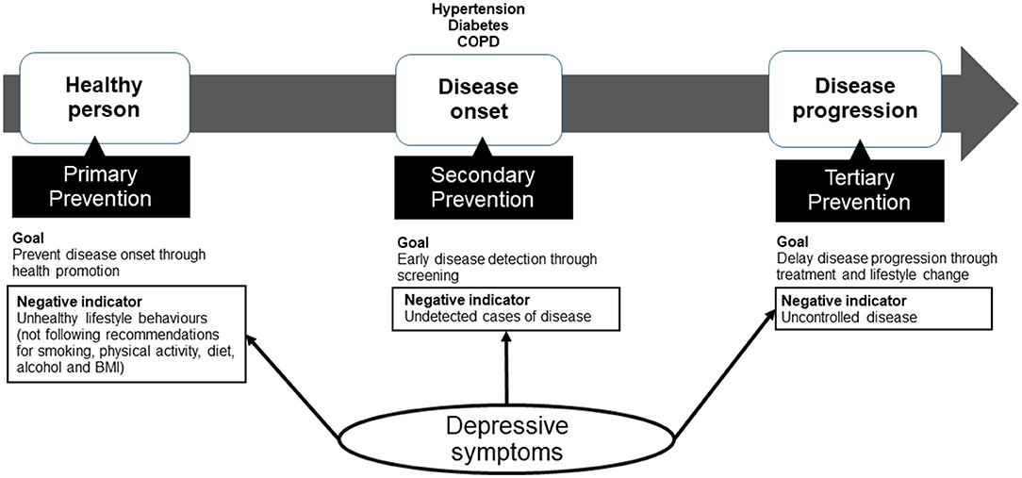
Progression from Prevention to Treatment

Slide 5
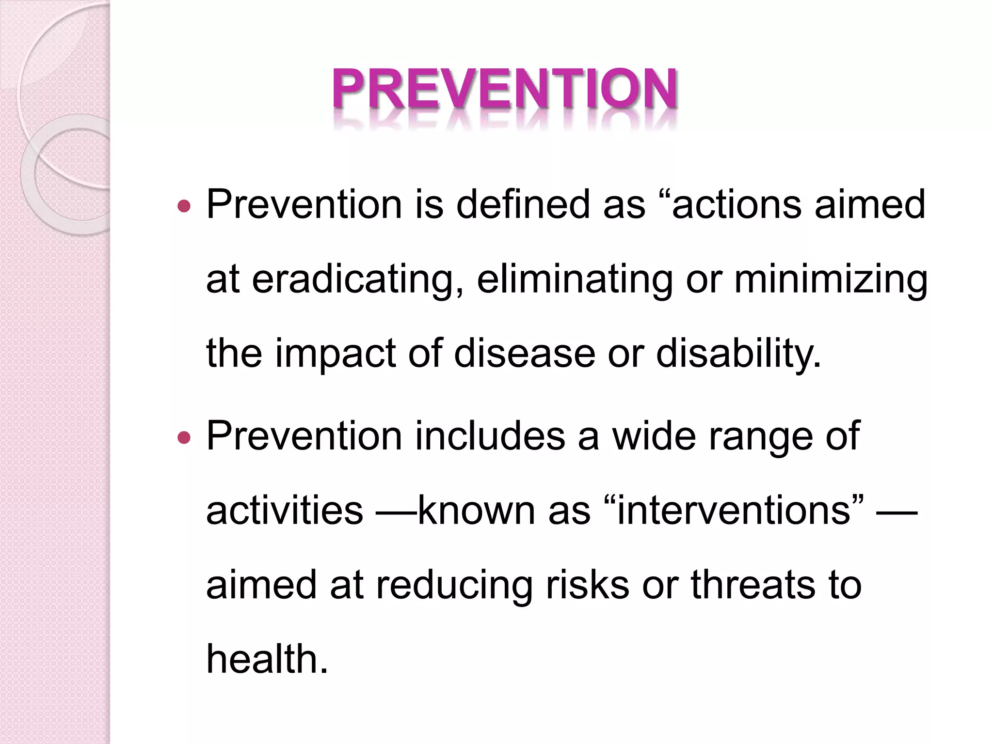
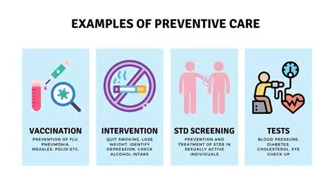
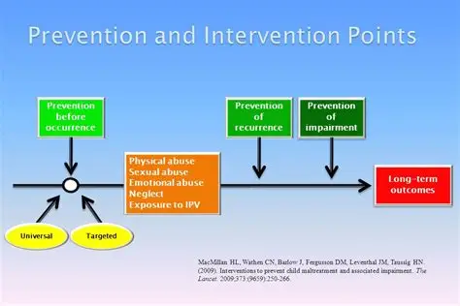
Prevention: Definition, Examples & Intervention Points

Slide 6
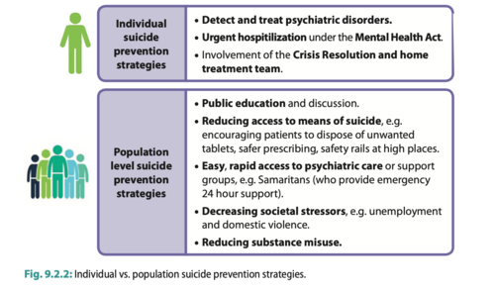
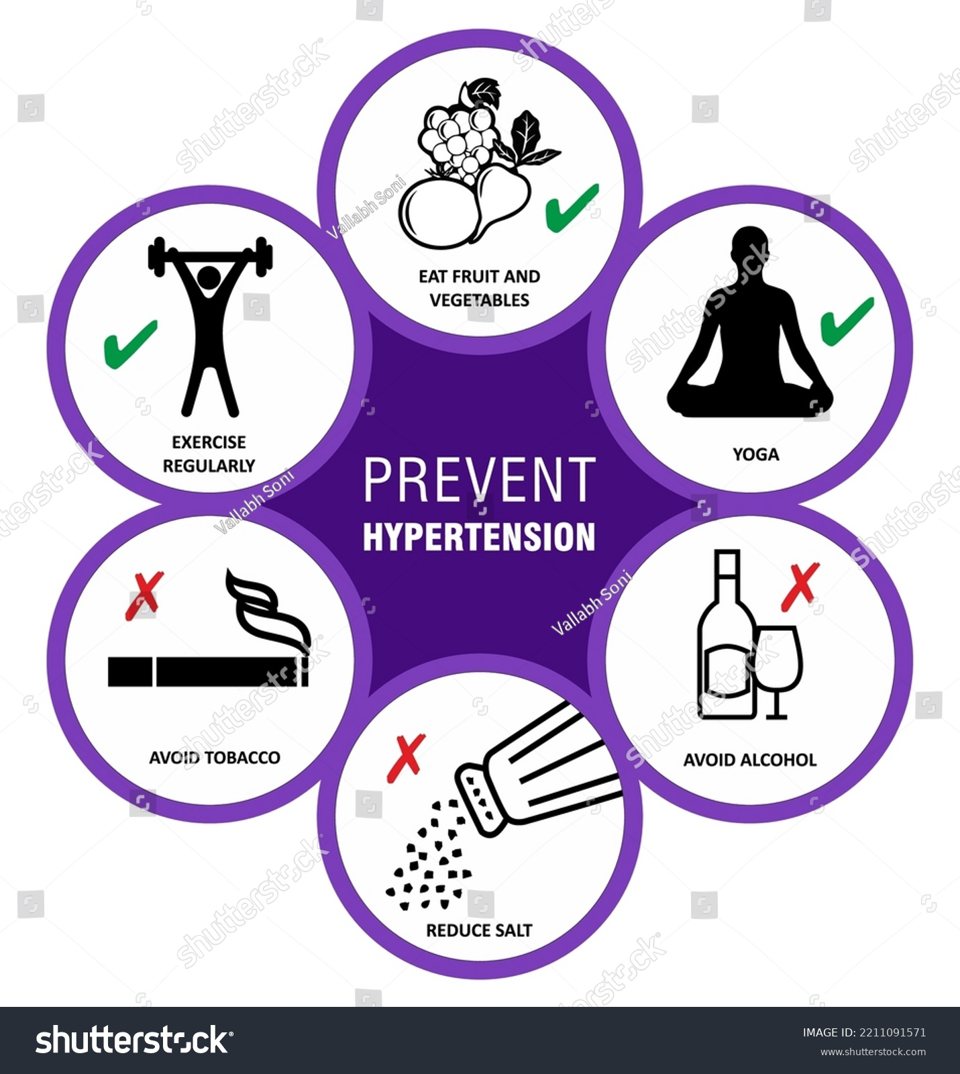
Individual vs Population-level Prevention Strategies

Slide 7
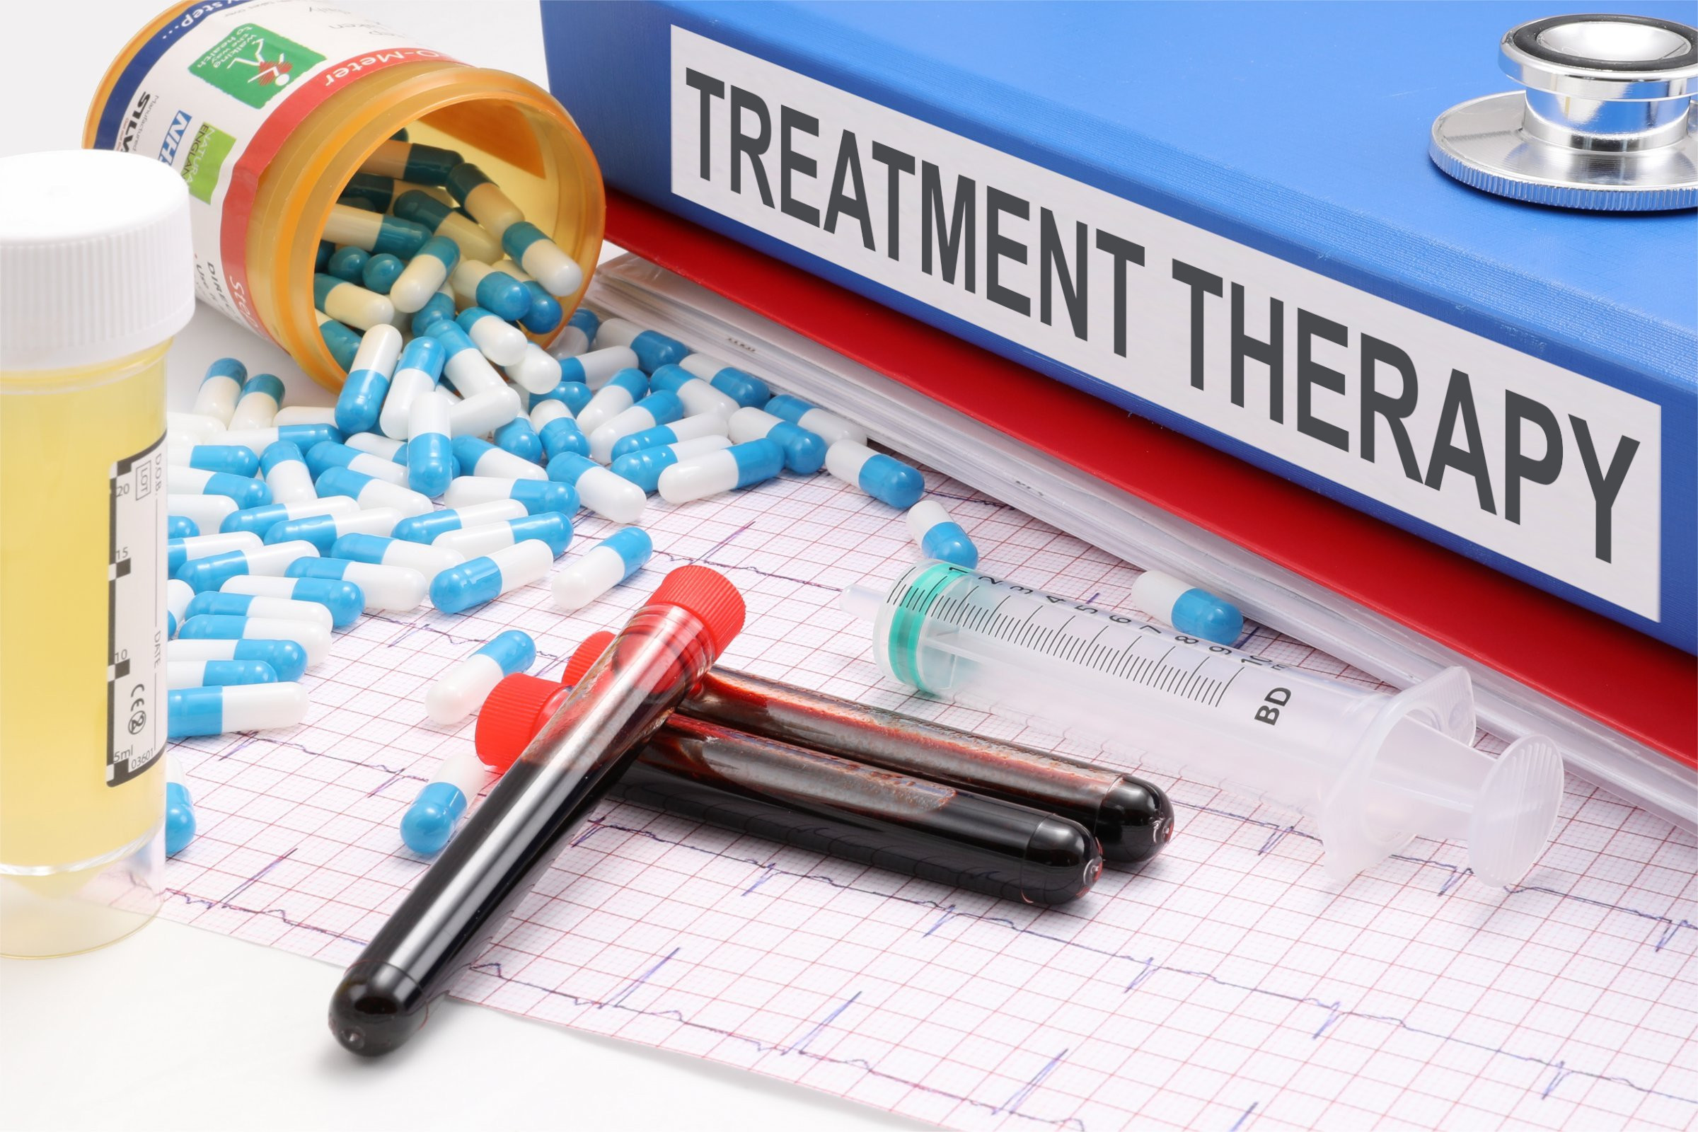
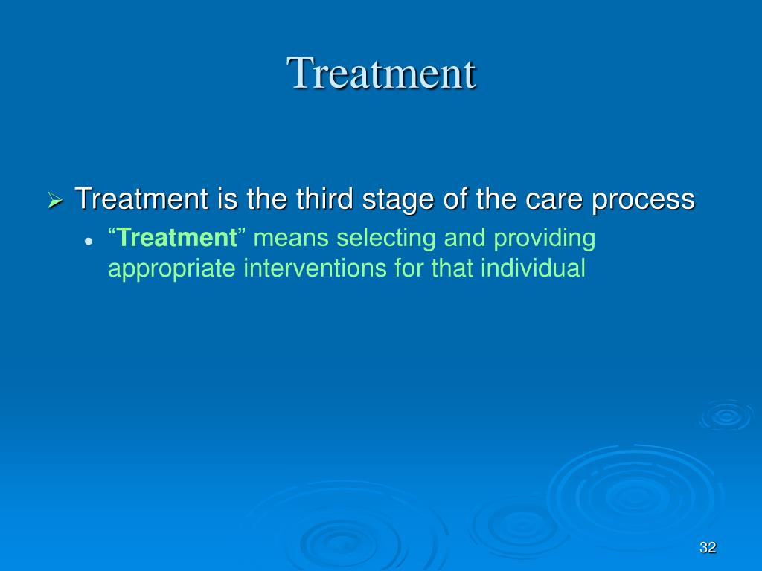
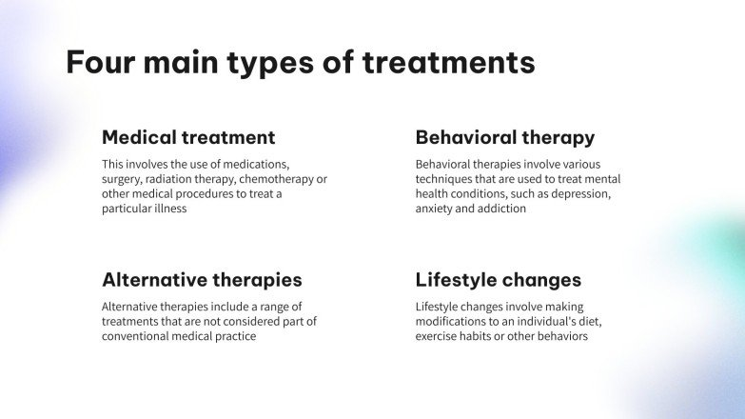
Treatment: Definition & Types

Slide 8

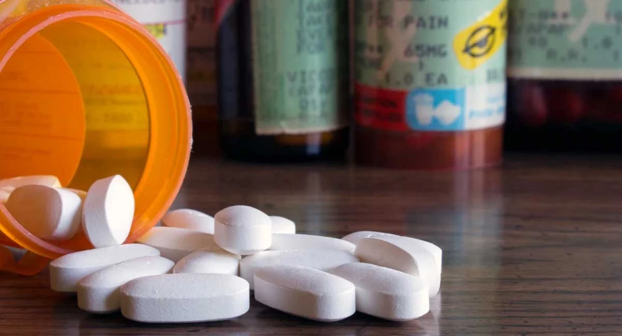
Medicines for the Treatment of Disease
Medicines are substances or compounds designed to cure, prevent, or relieve diseases.
The wide variety of available treatments can address everything from a common cold to chronic diseases
Medicines reduce the overall burden of disease and premature death
The value of medicines derives not only from the health outcomes that they deliver but also from the broader non- health impacts to our society, the community and the economy.
Medicines generate broader economic value to the Government through health and wellbeing and through second round effects of improving productivity, increasing GDP, generating government revenue through income tax collection and reducing expenditure on welfare benefits
Source: https://www.medicinesaustralia.com.au/publications/issues-briefs/value-of-medicines/

Slide 9
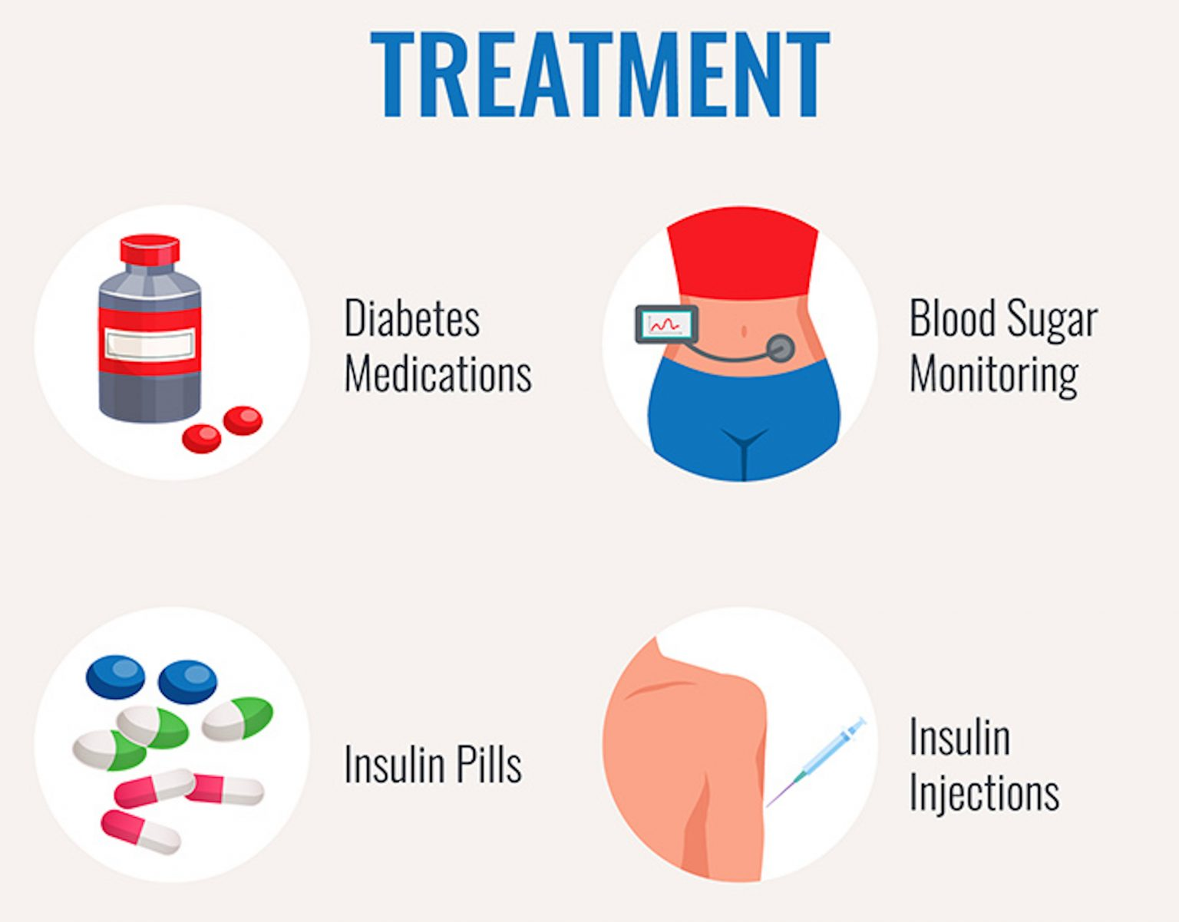
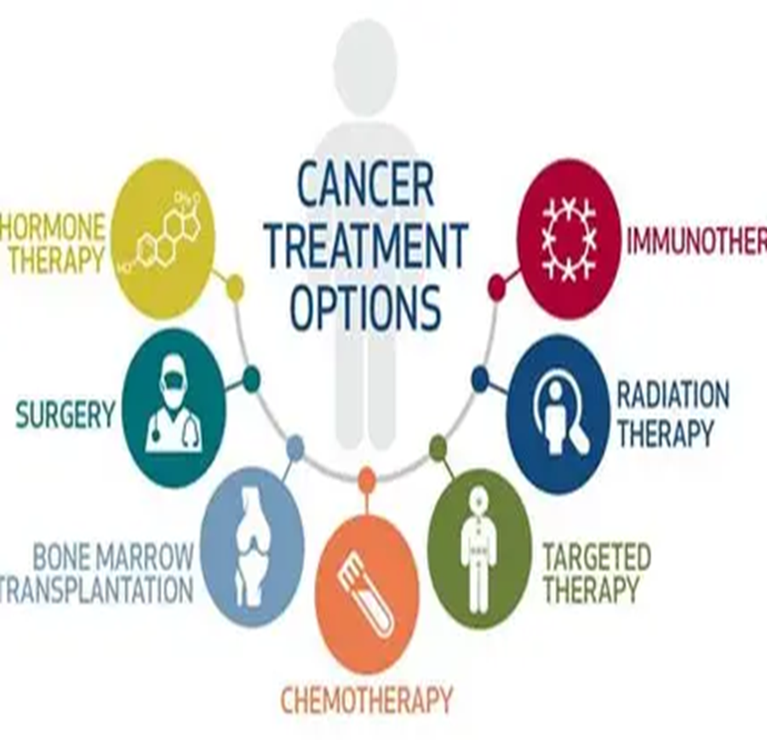
Treatment options for Diabetes & Cancer

Slide 10
Clinical medicine (Treatment) vs Public health (Prevention)
Clinical medicine emphasizes the diagnosis, treatment, and management of individual patients, addressing immediate health concerns.
Expertise in disease management
Patient-centered approach
Public health focuses on preventing diseases, promoting health, and improving population health outcomes through interventions and policies.
Population-level perspectives
Translating Research into Practice
Purpose is cure of disease and alleviation of suffering in individuals
Emphasis on treatment of illness
Based largely on basic biology and biomedical sciences
Uses deterministic reasoning based on pathophysiology
Located in hospitals, clinics, and offices
Goal is the prevention or control of disease in a population
Emphasis on disease prevention and early detection
Depends on epidemiology and statistics
Relies on probabilistic analysis and causal inference
Based in organizations, mostly within governments and communities
Sources: Phillips R. Bridging the gap: Clinical medicine applied in public health. J Pub Health Nutri. 2023;6(3):148
Mushlin AI. Covid-19: an Imperative to Bridge the Gap Between Medicine And Public Health. J Gen Intern Med. 2020 Aug;35(8):2445-2446. doi: 10.1007/s11606-020-05932-w. https://pmc.ncbi.nlm.nih.gov/articles/PMC7269618/
Notes:
Therapeutic measures are Interventions taken after a disease or health issue has already occurred, with the goal of treating or managing the condition.

Slide 11
Preventive versus Treatment measures
Attribute | Preventive measures | Therapeutic measures
Goal | To avoid the occurrence of a disease or health issue | To treat and cure a disease or health issue
Timing | Implemented before the onset of a disease | Implemented after the onset of a disease
Focus | Emphasis on maintaining health and wellness | Emphasis on alleviating symptoms and curing illness
Methods | Includes vaccinations, screenings, healthy lifestyle choices | Includes medications, surgeries, therapies
Both preventive and therapeutic approaches are important in maintaining and improving overall health, with preventive measures being proactive & therapeutic measures being reactive in nature
Source: https://thisvsthat.io/preventive-vs-therapeutic

Slide 12
Preventive versus Treatment measures
Attribute | Preventive | Therapeutic
Accessibility | Often more accessible to a wider population, as they can be implemented by individuals in their daily lives. Include actions such as eating a healthy diet, exercising regularly, and getting recommended screenings | May require access to healthcare providers, medications & medical facilities, which may not be as readily available to everyone
Cost | More cost-effective in the long run; can help avoid the need for expensive treatments or hospitalizations down the line. Investing in preventive care leads to overall savings on health care costs by reducing the incidence of preventable diseases | Can be more costly, as they often involve ongoing treatments, medications & medical procedures to manage a health condition
Effectiveness | Generally, more effective at reducing the risk of developing certain diseases or health issues eg getting regular screening for cancer can help with early detection when it is more treatable. | Aimed at treating a disease that has already developed, and may not always be able to fully cure the condition
Long-term Impact | Have the potential for long-term impact on overall health & well-being by reducing the risk of developing NCDs/health issues. By adopting healthy habits early on, individuals can improve their quality of life & potentially extend their lifespan | May provide short-term relief from symptoms or manage a condition, but may not always address the underlying causes of the disease
Source: https://thisvsthat.io/preventive-vs-therapeutic

Slide 13
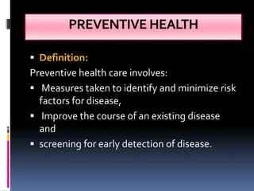
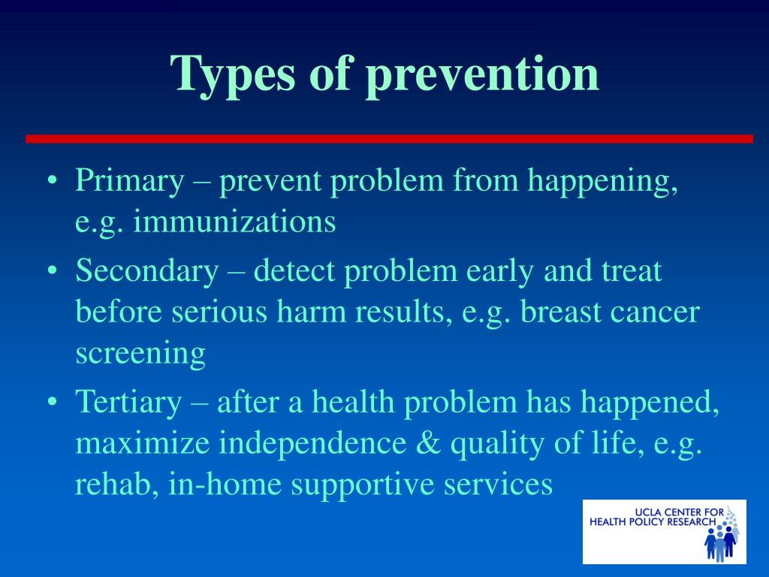
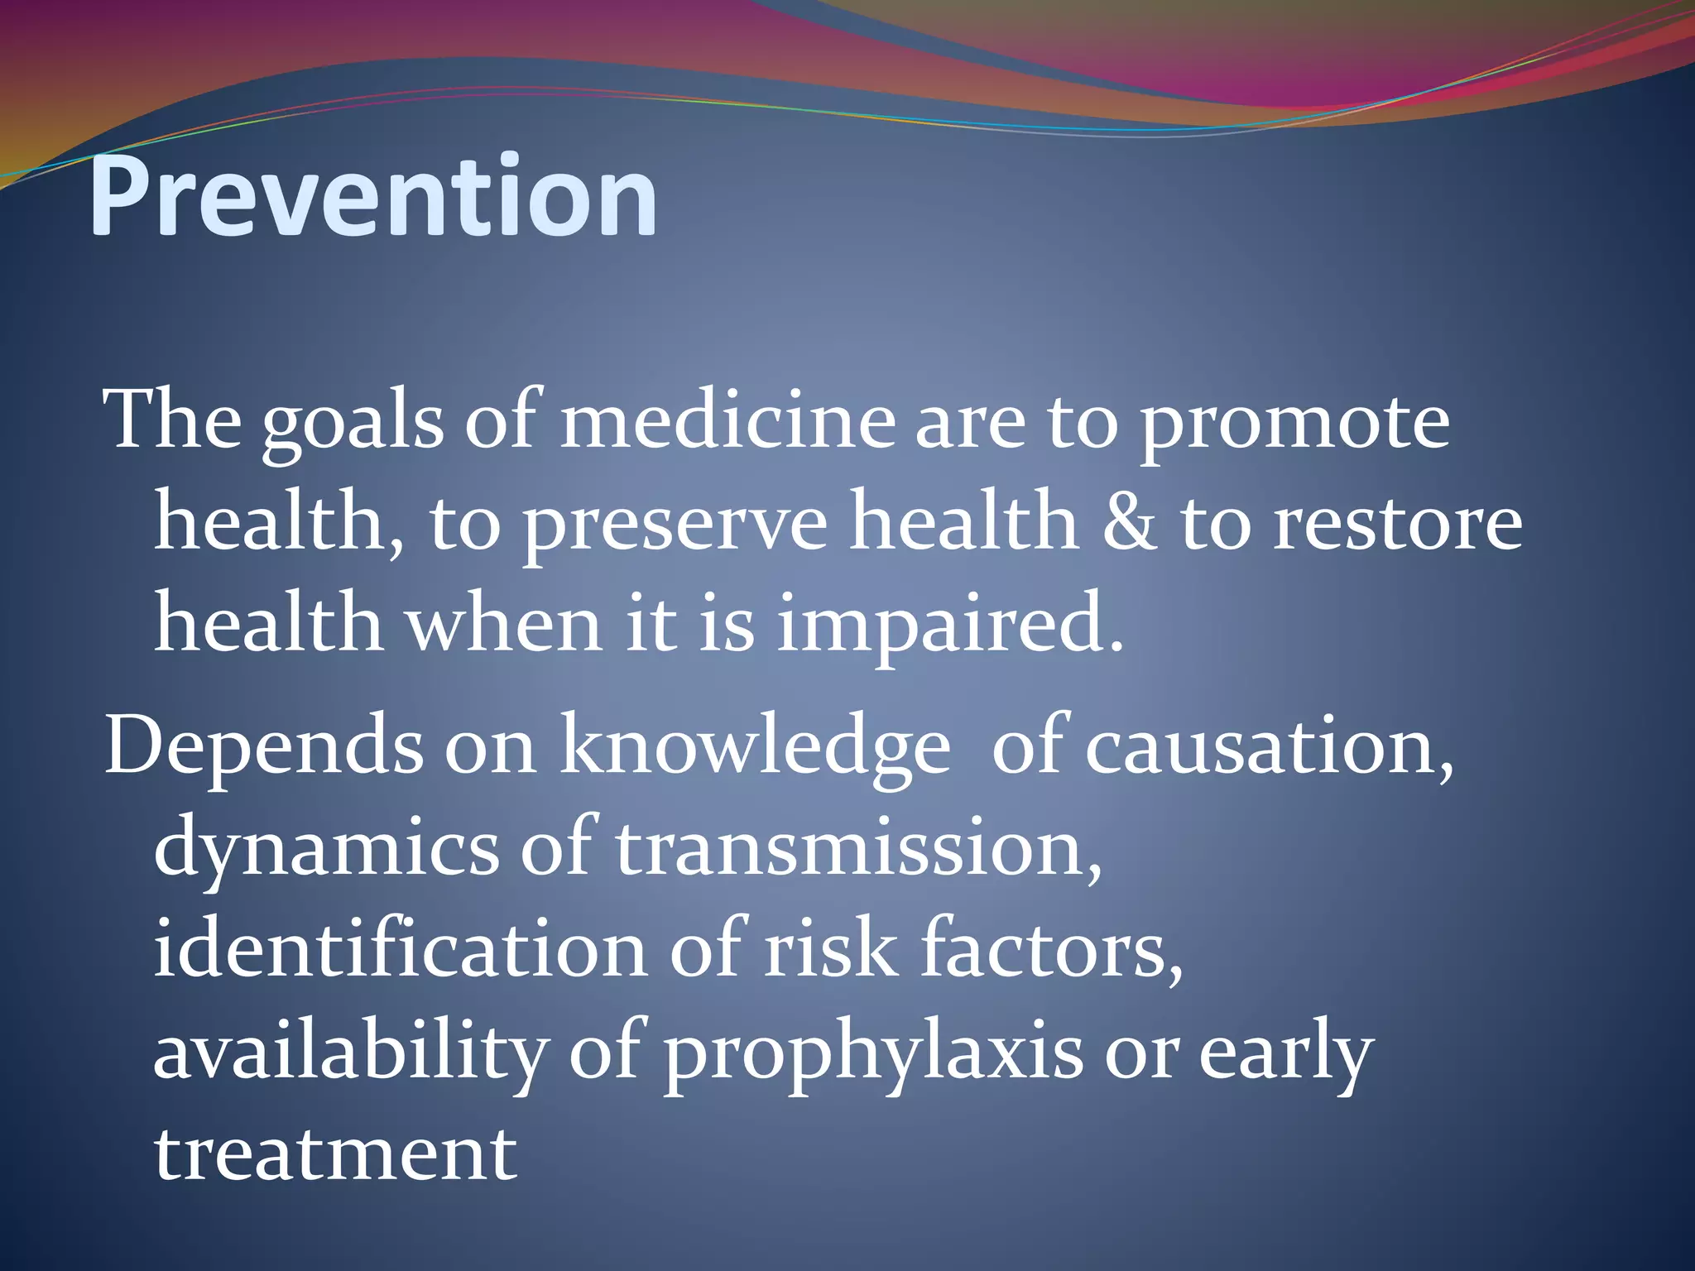
About Preventive Measures
Preventive measures are Actions taken to avoid the occurrence of a disease or health issue. These can include lifestyle changes, vaccinations, screenings, and regular check-ups

Slide 14
Vaccines and/or Medicines
Vaccines are indispensable in public health, significantly reducing the incidence of contagious and life-threatening diseases.
By achieving high vaccination rates, communities can establish herd immunity, protecting those who cannot receive vaccines, such as infants and immunocompromised individuals.
Immunization campaigns have demonstrated success in eradicating and controlling diseases, highlighting the critical role vaccines play in safeguarding both individual and community health.
Medicines enable us to more effectively treat the leading driver of health care costs: chronic disease.
Medicines play a central role in making our health care system more sustainable.
Use of medicines can help patients avoid other costlier services, such as emergency room visits, hospital stays, surgeries and long-term care.
Yet, despite the many health and economic benefits medicines provide, significant gaps in the appropriate use of medicines remain.
This is particularly true for patients with chronic disease.

Slide 15
Why the Use of Preventive Services Is Still Low
Financial and economic considerations.
Use of metrics to drive change in the health care system
Role of health care payers
Rapid changes in health care reimbursement models
Source: Levine S, Malone E, Lekiachvili A, Briss P. Health Care Industry Insights: Why the Use of Preventive Services Is Still Low. Prev Chronic Dis 2019;16:180625https://www.cdc.gov/pcd/issues/2019/18_0625.htm

Slide 16
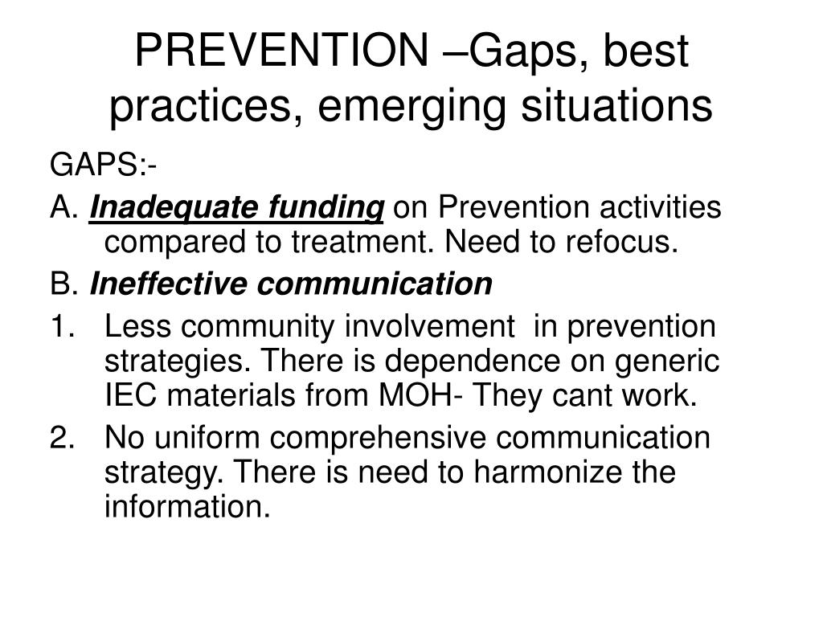
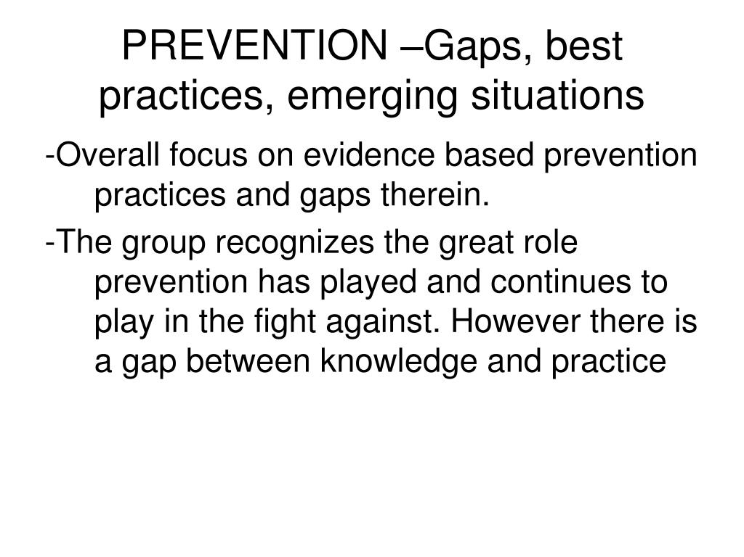

Slide 17
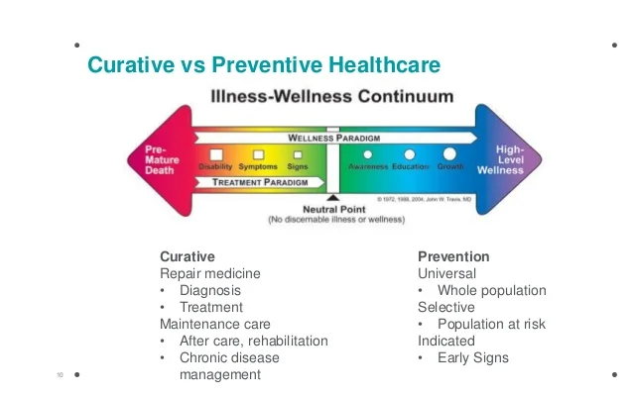
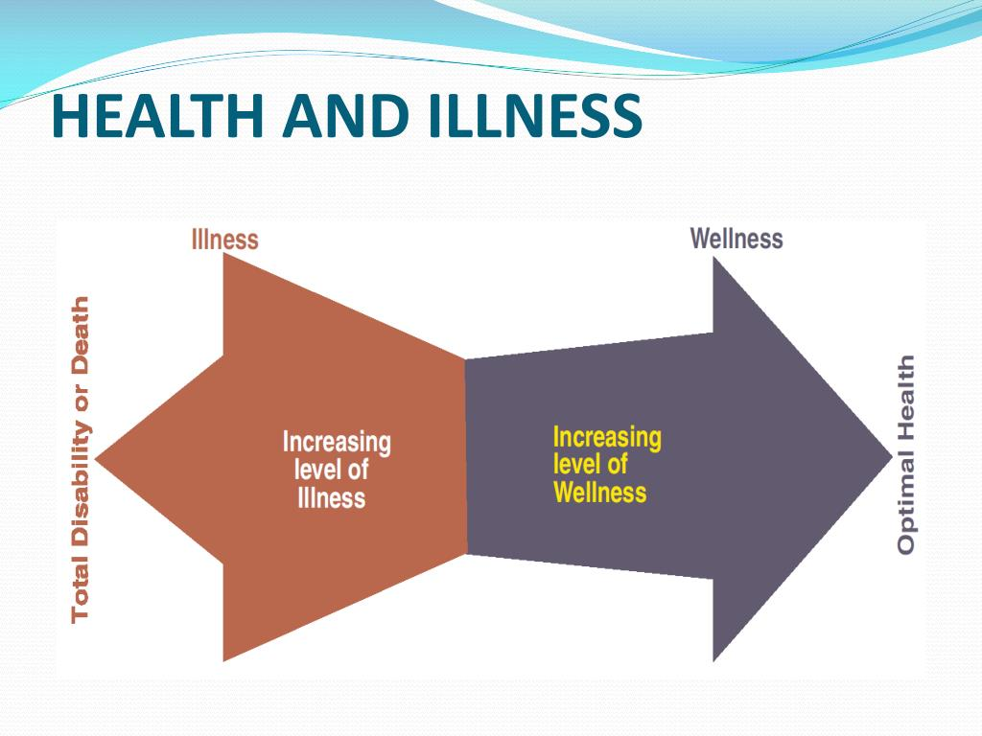
Gap between Prevention and Treatment/Care

Slide 18
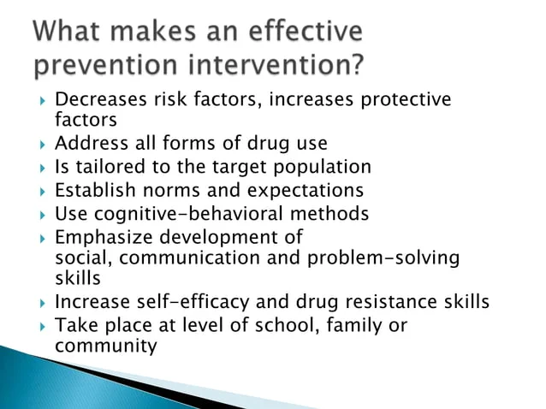

Slide 19
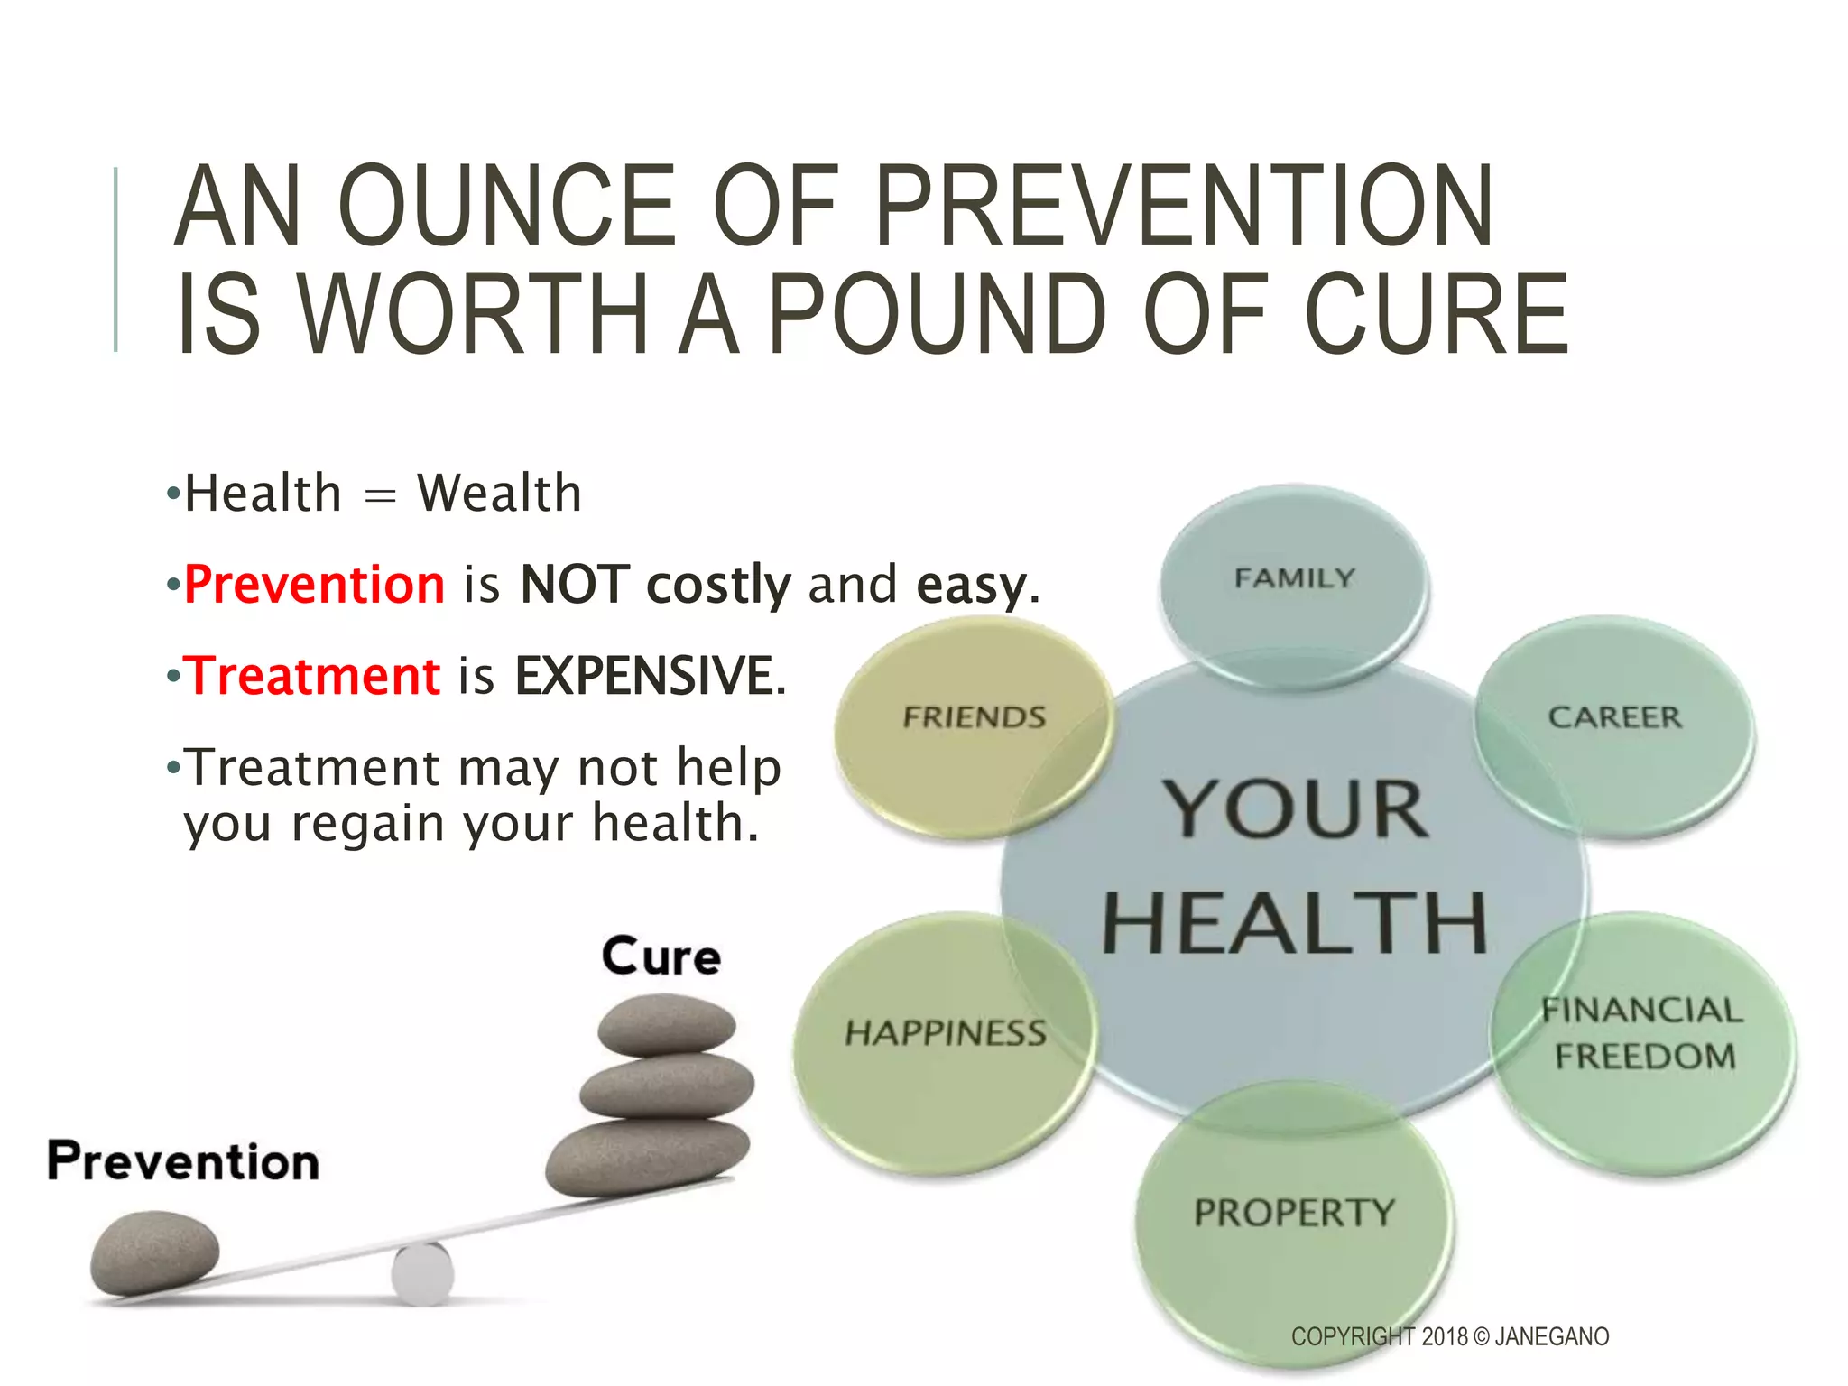
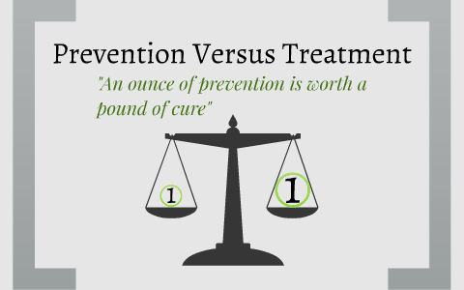
However, “prevention is underfunded while treatment attracts greater overall priority”
Halley S. Faust and Paul T. Menzel (eds.), Prevention vs. Treatment: What’s the Right Balance?, Oxford University Press, 2012,

Slide 20
“Prevention Praised, Cure Preferred…”
'It is better to prevent than to cure’ is an old adage that reaches as far back as Hippocrates in Ancient Greece. This preference for prevention over treatment ensues from the idea that small preventive efforts can substantially decrease, or altogether remove, substantial negative future outcomes.
‘An ounce of prevention is worth a pound of cure’ is a common saying, and indeed, most health economic studies conclude that people are more willing to pay for preventive measures than for treatment activities.
National Institute for Public Health and the Environment in the Netherlands claims that, in many cases, preventive efforts can lead to great health benefits at only a small expense. This praise in favor of prevention would suggest that prevention is preferred over treatment.
In the Netherlands, a mere 5% of the health care budget is spent on prevention while about 40% is spent on curative measures.
Studies in the United States show comparable figures despite U.S. citizens believing that the greater share of health spending should be earmarked for prevention rather than treatment of disease (1999 Harris Poll)
Source: Meertens RM, Van de Gaar VM, Spronken M, de Vries NK. Prevention praised, cure preferred: results of between-subjects experimental studies comparing (monetary) appreciation for preventive and curative interventions. BMC Med Inform Decis Mak. 2013 Dec 18;13:136. doi: 10.1186/1472-6947-13-136

Slide 21
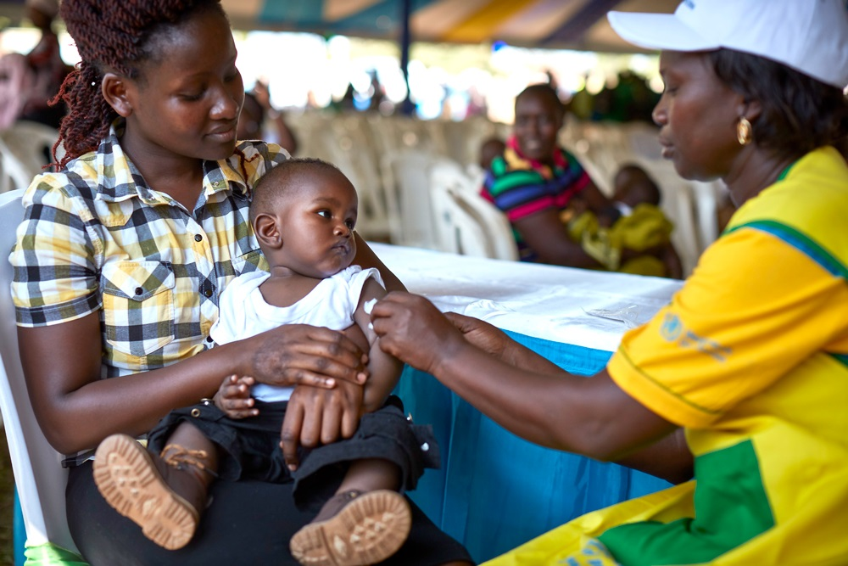
Vaccines & Immunization for Prevention of Disease
WHO) defines immunisation as one of the most successful and cost-effective health interventions ever implemented⁸
Immunization is a global health success story, saving millions of lives every year.
Vaccines reduce risks of getting a disease by working with your body’s natural defenses to build protection.
We now have vaccines to prevent more than 30 life-threatening diseases and infections, helping people of all ages live longer, healthier lives.
Immunization currently prevents 3.5 million to 5 million deaths every year from diseases like diphtheria, tetanus, whooping cough, influenza and measles.
Immunization is key to primary health care, an indisputable human right, and one of the best health investments money can buy.
They underpin global health security and are a vital tool in the battle against antimicrobial resistance.
Source: https://www.who.int/health-topics/vaccines-and-immunization/#tab=tab_1

Slide 22
Preferences for Treatment vs Prevention
Time interval required for benefits to be seen plays a role. In prevention, positive outcomes tend to be long term, whereas with treatment, the positive results are often evident in the short term. Research shows that health gains that occur immediately are preferred over delayed health gains. Therefore, treatment, with its short-term results, is preferred over prevention with its long term payoff.
The certainty of the cause and effect can impact evaluations of prevention and treatment. People prefer a certain positive outcome (e.g. a sure gain of $240) over a less certain but even more positive outcome (e.g. 25% chance to gain $1000). As such, a more certain treatment may be valued more than uncertain prevention.
The urgency of an intervention is influenced by the degree to which the need for intervention is tangible. With prevention, positive outcomes tend to only be evident at a collective level, whereas with treatment, success can be seen at the individual level. Because people are generally more willing to spend resources to save the life of identifiable individuals, they are probably also more likely to value programs that help identifiable people (i.e., treatment programs) rather than programs that help people that are merely represented by statistics (i.e., preventive programs).
The proportion of the reference group that can be 'saved’ is greater in treatment programs than it is in prevention programs. This means that for more people the preventive intervention is a waste of time. This too may lead to a preference for, and a higher measured appreciation of treatment over prevention.
Source: Meertens RM, Van de Gaar VM, Spronken M, de Vries NK. Prevention praised, cure preferred: results of between-subjects experimental studies comparing (monetary) appreciation for preventive and curative interventions. BMC Med Inform Decis Mak. 2013 Dec 18;13:136. doi: 10.1186/1472-6947-13-136
Notes:
.

Slide 23
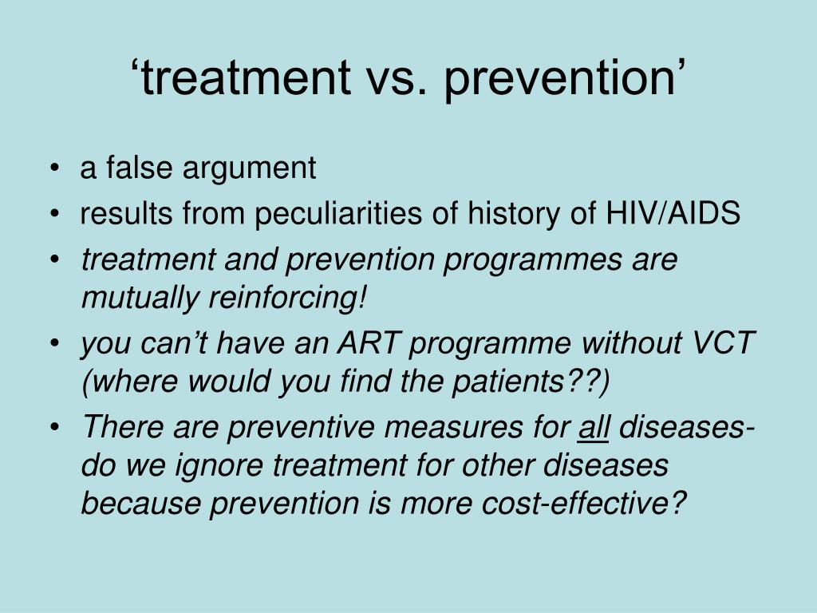

Slide 24
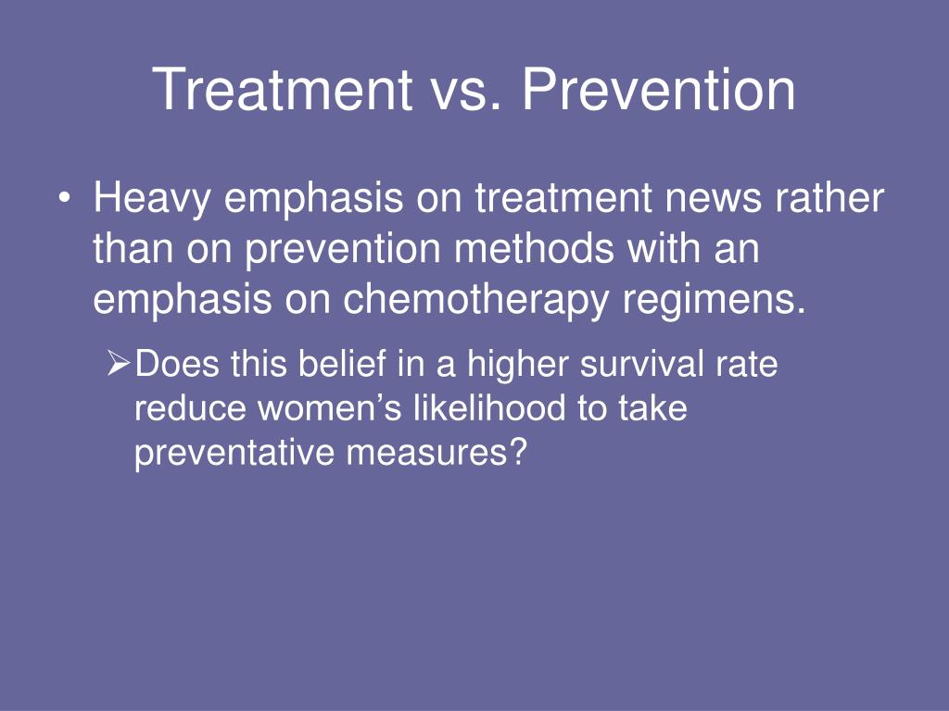

Slide 25
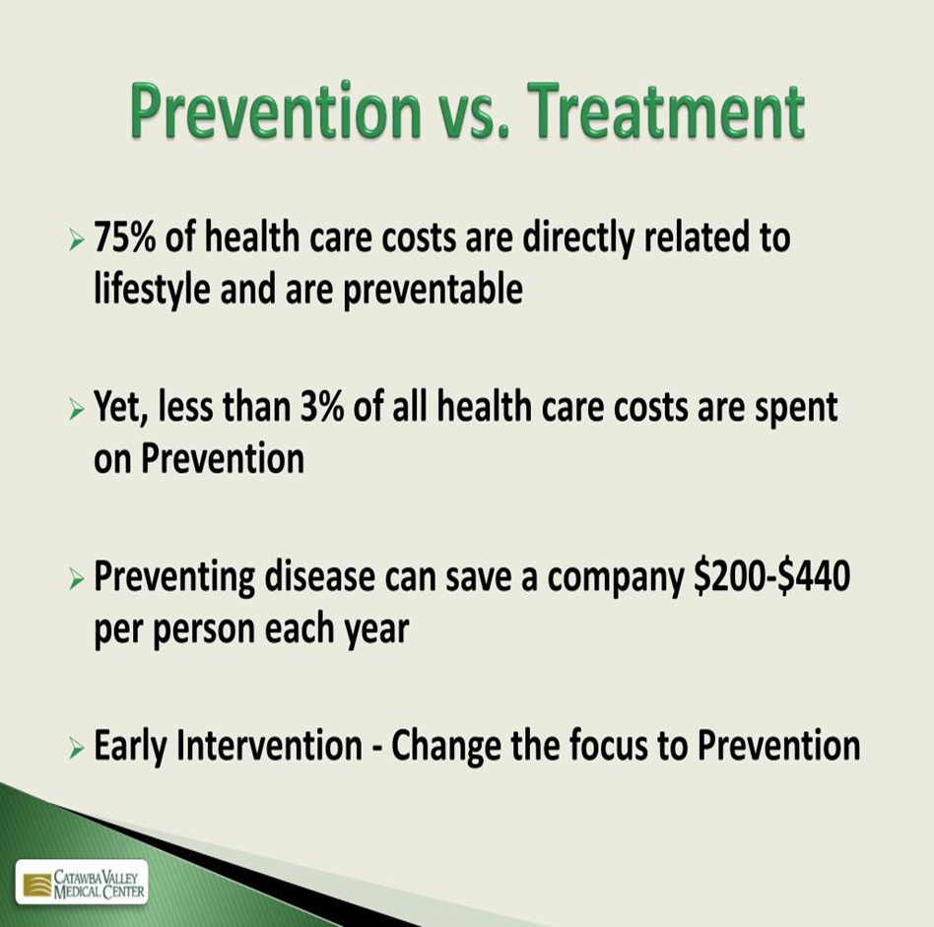

Slide 26
Health Policy Shift in Favour of Prevention
The last 20 years has seen a substantial growth in health policies stressing the need for “prevention orientated” solutions over treatment provision as an approach to addressing health needs.
Such an approach infers that there is a clear distinction between the two approaches and that a shift of resources from current care modalities, with their emphasis on addressing health needs through treatment orientated health services, to approaches that adopt prevention interventions aimed at addressing problems before they arise, will provide better outcomes, not least in terms of use of resources.
Source: Batchelor P (2015). The false dichotomy between prevention and tratment and why it needs to be addressed. Available at https://www.academia.edu/129067357/The_false_dichotomy_between_prevention_and_tratment_and_why_it_needs_to_be_addressed

Slide 27
The false dichotomy between prevention & treatment
We have an oversimplified dichotomy between prevention and treatment in health policy.
Chronic diseases have replaced acute conditions as the primary health challenges, necessitating a paradigm shift.
Life course epidemiology provides critical insights into how early factors influence long-term health outcomes.
A unified approach integrating both prevention and treatment is essential for effective health management.
Policy should focus on the health impacts of interventions across an individual's lifespan, not just their preventive aspects.
Source: Batchelor P (2015). The false dichotomy between prevention and tratment and why it needs to be addressed. Available at https://www.academia.edu/129067357/The_false_dichotomy_between_prevention_and_tratment_and_why_it_needs_to_be_addressed

Slide 28
Health Justice in Treatment and Prevention
Daniels's account of health justice holds that "we have a robust social obligation to protect and promote health and that this obligation means we owe each other a reasonable array of both preventive and curative interventions" (176).
Given limited resources and other pressing social concerns, this is not an obligation to provide all possible health-promoting assistance.
Daniels has long been skeptical that there is one right way to allocate scarce resources, and he encourages citizens to engage one another in respectful deliberation to arrive at publicly legitimate (if not timelessly true) approaches to rationing.
This is his general tack toward the prevention/treatment trade-off as well, although he stresses that socially disadvantaged groups should be granted special priority (especially for prevention) in light of the greater social and environmental risks they encounter.
Daniels's new positive argument for treatment's limited priority focuses on the fact that those in need of treatment are often "clearly worse off" than those who can benefit from prevention (189). Specifically, they are worse off in having much higher baseline risk.
Norman Daniels (2012)"Treatment and Prevention: What Do We Owe Each Other?" .
https://ndpr.nd.edu/reviews/prevention-vs-treatment-what-s-the-right-balance/

Slide 29
A Balance Between Prevention and Treatment?
Russell's boldest and most intriguing thesis is that "the balance between prevention and cure, at least in the medical sector, may not be so far wrong after all" (75). This claim stems from studies that show prevention and treatment are by and large equally cost-effective.
Cost-effectiveness analysis (CEA) is a health economic framework that compares a given intervention's monetary cost with its expected health benefit. Health benefits are usually measured in quality-adjusted life-years (QALYs), which combine quality-of-life and longevity into one metric by multiplying a given health state's quality score by the time (in years) spent living in that state. Quality scores range from zero ("as bad as death") to 1 ("full health").
Philosophers have raised concerns about CEA, because they have mostly ignored a feature relevant to the prevention vs. treatment debate.^{[1]} - cost-effectiveness studies virtually never evaluate the overall efficiency of the prevailing mix of covered interventions; they instead answer the narrower question of how much more expensive and/or more beneficial a new intervention is when compared to the current standard of care for a specific health problem.
Thus, standard CEAs evaluate new interventions in terms of their incremental cost-effectiveness, i.e., the ratio of the new intervention's additional costs to its additional benefits
Louise B. Russell (2012) "Prevention vs. Cure: An Economist's Perspective on the Right Balance. https://ndpr.nd.edu/reviews/prevention-vs-treatment-what-s-the-right-balance/
Notes:
Louise B. Russell and is titled "Prevention vs. Cure: An Economist's Perspective on the Right Balance.

Slide 30
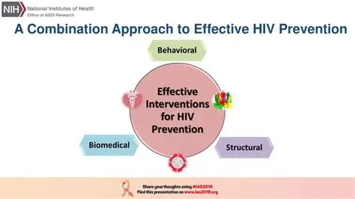
Unified approach between Prevention and Treatment

Slide 31
Debate: Gap between Prevention and Treatment
The debate between prevention and treatment centers on the balance between proactive measures to avert disease and reactive responses to illness. While prevention is often seen as a cost-effective strategy with long-term benefits, treatment can provide immediate relief but may come with higher costs and potential side effects.
Is there a unified approach that integrates both prevention and treatment, considering the changing nature of health conditions and the importance of early detection and intervention.
If so, give practical examples

